Slide 1
Parameters (base model) AIC = 547.12 -LogLik = 273.56
Abbrev | Symbol | Full parameter name (fix or potentially estimate*) | Initial (or fitted) value
delM | δ_{M} | Shape corrector (fix) | 0.1066
dV | d_{V} | Dry weight density (fix) | 0.4
sJAm | Jª_{Am} | Area-specific assimilation rate | 0.333
sJM | J^{v}_{M} | Volume-specific maintenance costs | 0.0214
WB0 | W_{B0} | Initial egg weight (fix) | 0.15
Lwp | L^{M}_{p} | Total length at puberty (fix) | 100
yAV | y_{AV} | Yield of assimilates on volume, starvation (fix) | 0.8
yBA | y_{BA} | Yield of egg buffer on assimilates, reproduction (fix) | 0.95
yVA | y_{VA} | Yield of structure on assimilates, growth | 0.3646
kappa | κ | Allocation fraction to soma (fix) | 0.8
f | f | Scaled food level (fix) | 1
fB | f_{B} | Scaled food level, embryo (fix) | 1
Lwf | L_{f}? | Half-saturation total length (fix) | 0
mu_emb | h_{emb} | Mortality rate for embryos | 0.06393
mu_lar | h_{lar} | Mortality rate for larvae | 0.02940
Notes:
Can’t estimate kappa without reproduction data.

Slide 2
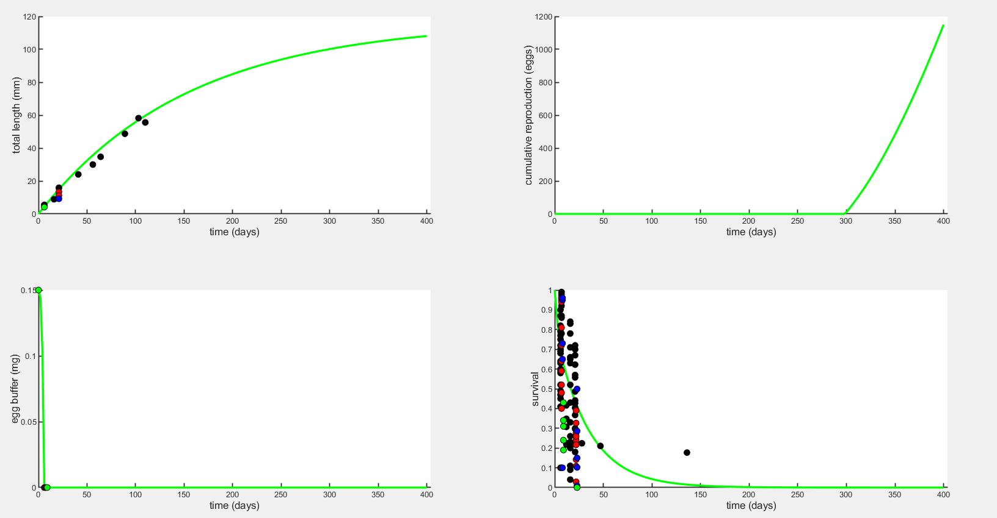
Plot to 400 days
Without hypoxia effect, the green line is control DO

Slide 3
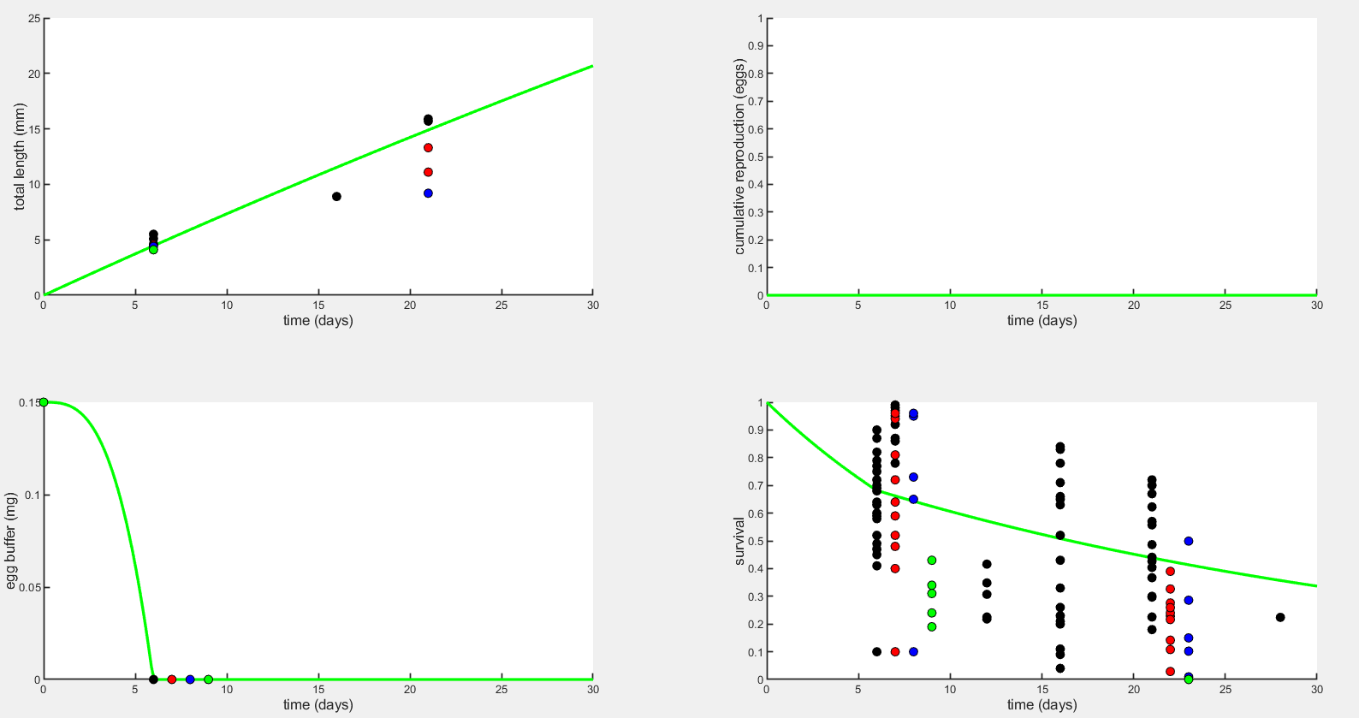
Plot to 30 days
Without hypoxia effect, the green line is control DO

Slide 4
Linear stress function
A = lower oxygen threshold, where s = 1
B = upper oxygen threshold, where s = 0
DO = dissolved oxygen (mg/L)
If A < s < B, then s = 1 – (DO – A)/(B – A)
If s > B then s = 0
If s < A then s = 1

Slide 5
Applying stress function to each parameter of interest
Parameter(s) affected by stress | Direction of effect | Stress expression | Best lower threshold | Best upper threshold | -LogLik | Notes
sJAm | ↓ | p/(1+s) | 0 | 4.8 | 288.019 | Fits survival well but not strong enough effect on length at ~20 dpf. Better fit than using p*(1-s).
yVA | ↓ | p/(1+s) | 1.5 | 4.8 | 270.174 | Fits survival fairly well except for lowest DO level, goes in between the two time points for length.
sJM | ↑ | p*(1+s) | 2.6 | 4.3 | 273.362 | Too weak of an effect on early life length, no effect on hatch time. Can we multiply it by 2 or 3?
mu_emb | ↑ | p*(1+s) | 1.0 | 5.0 | 267.39 | Doesn’t affect length or egg buffer (which is to be expected), and needs to be combined with yVA or sJAm to match difs in duration of embryo stage. Could set the thresholds to A=2.4 and B=3 so only 2.5 mg/L treatment is affected.
mu_lar | ↑ | p*(1+s) | 2.8 | 7.0 | 263.726 | Still doesn’t get mortality high enough for lowest DO level (note that with this threshold, s=1 for that DO level).
sJAm & sJM | ↓ & ↑ | p/(1+s) & p*(1+s) | 0 | 4.8 | 289.505 | I think there would need to be two different stress functions to have an effect from sJM because this fit is almost identical to just using sJAm.
yVA & sJM | ↓ & ↑ | p/(1+s) & p*(1+s) | 1.5 | 4.8 | 270.123 | Same as sJAm & sJM – predominant effect is from yVA, sJM effect is minimal.
“Stress expression” is how the stress value is applied to the parameter (p) in equations. Examples in Jager (2018) Table 5.2.

Slide 6
Applying stress function to each parameter of interest (cont)
Parameter(s) affected by stress | Direction of effect | Stress expression | Best lower threshold | Best upper threshold | -LogLik | Notes
sJAm & mu_emb | ↓ & ↑ | p/(1+s) & p*(1+s) | 0.5 | 4.8 | 289.606 | Pretty good, but survival at hatching is too low for DO=3 mg/L.
yVA & mu_emb | ↓ & ↑ | p/(1+s) & p*(1+s) | 1.5 | 4.8 | 264.802 | This threshold combo had lower -LogLik but could change to get better fit to egg buffer and survival specifically, but -LogLik goes up then.
sJM & mu_emb | ↑ & ↑ | p*(1+s) | 2.0 | 5.0 | 265.979 | Minimal effect on early life length, no effect on hatch timing. Mainly survival.
sJAm & mu_lar | ↓ & ↑ | p/(1+s) & p*(1+s) | 1.0 | 5.0 | 297.337 | Another case where different survival functions for each parameter might help. Mu_lar wants a stronger one but sJAm (egg buffer and length) wants a weaker one.
yVA & mu_lar | ↓ & ↑ | p/(1+s) & p*(1+s) | 1.5 | 5.0 | 271.553 | This works pretty well except for the lowest DO level.
sJM & mu_lar | ↑ & ↑ | p*(1+s) | 2.8 | 7.0 | 263.45 | Similarly to with mu_emb, mainly survival effect with little maintenance effect.
mu_emb & mu_lar | ↑ & ↑ | p*(1+s) | 2.5 | 5.0 | 261.709 | This is a pretty good fit for survival.
sJAm, mu_emb, & mu_lar | ↓&↑&↑ | p/(1+s) & p*(1+s) | 0.5 | 4.8 | 287.524 | Pretty good, except again sJAm wants a different set of thresholds than mortality.
“Stress expression” is how the stress value is applied to the parameter (p) in equations. Examples in Jager (2018) Table 5.2.

Slide 7
Stress function
Thresholds affect the slope and where the treatments fall along the function (i.e. how close the treatments are to the thresholds affects severity of stress at each treatment).
Should we make A and B parameters and estimate them? In this exercise I was visually fitting them by changing the thresholds to get a good fit.
Or let it estimate the parameter(s) the stress function is applied to?

Slide 8
Plot legend
Black = 8 mg/L (control)
Red = 4 mg/L
Blue = 3 mg/L
Green = 2.5 mg/L

Slide 9
Mean data values for each DO treatment
This could be useful when viewing the plots and how well the predicted values fit (because for survival and length there are multiple data points on the plot).
 | 7.7 mg l⁻¹ | 4.2 mg l⁻¹ | 3.1 mg l⁻¹ | 2.7 mg l⁻¹
Survival to hatching | 74.3% (range 41-100%) | 70.6% (range 40-100%) | 85.8% (range 65-100%) | 30.2% (range 19-43%)
Hatch time (egg buffer=0) | 6 days | 7 days | 8 days | 9 days
Length at hatching | 5.3 mm | 4.55 mm | 4.4 mm | 4.1 mm
Larval length at 15 dph* | 15.8 mm | 12.2 mm | 9.2 mm | NA
Larval survival to 15 dph* | 44.0% (range 4-84%) | 22.2% (range 3-33%) | 20.9% (range 1-50%) | 0% (range 0-0%)
*15 days post hatching = 21-24 days post fertilization, because low oxygen delays hatching

Slide 10
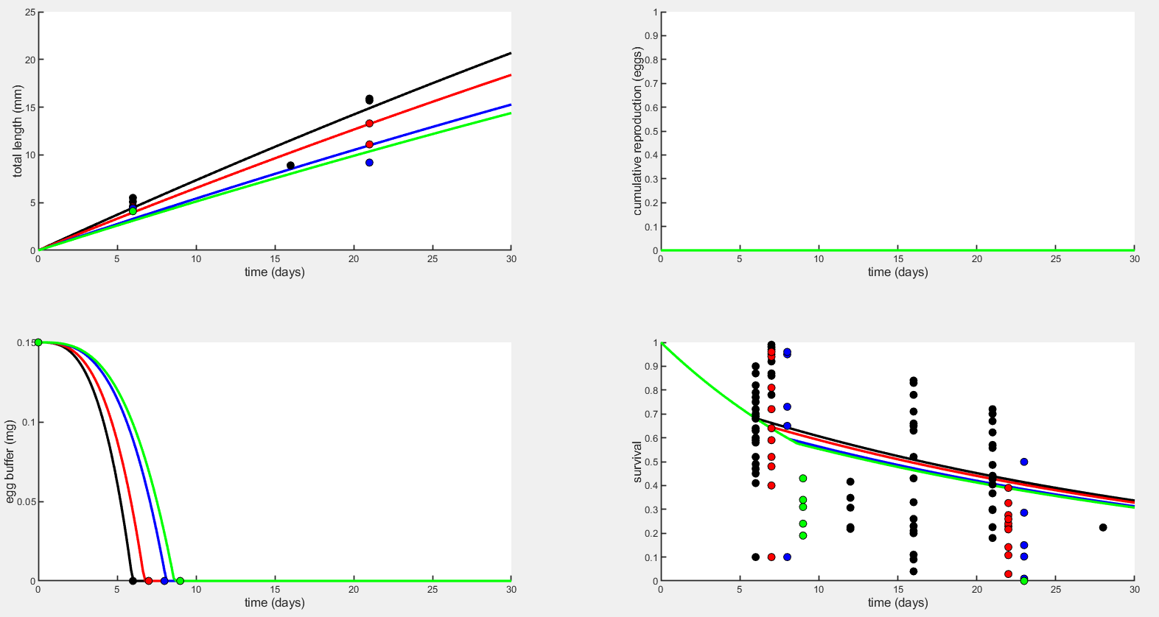
Early life plots – Assimilation (sJAm)

Slide 11
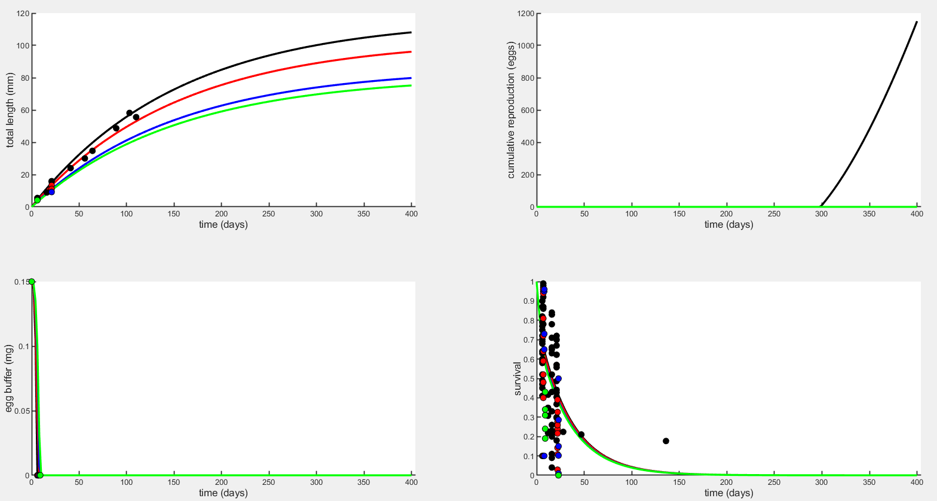
Full life plots – Assimilation (sJAm)

Slide 12
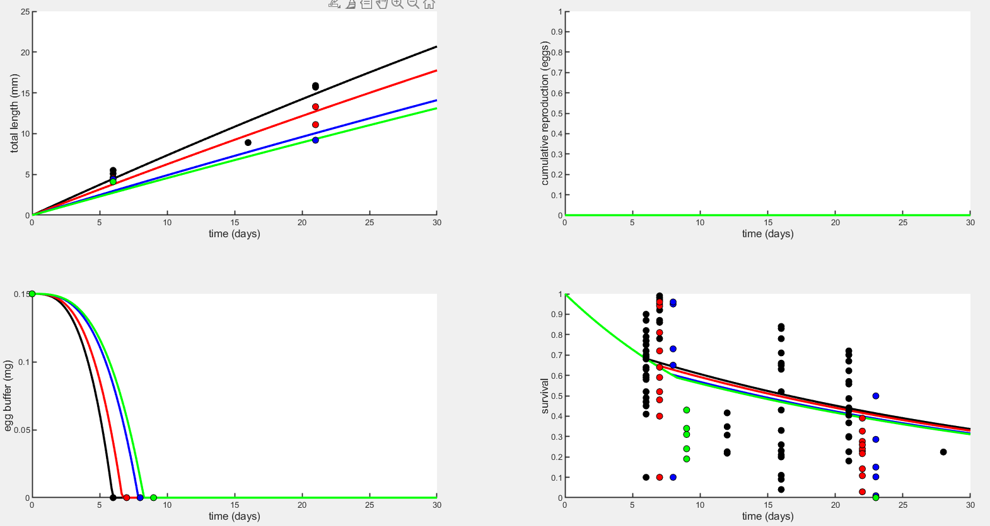
Early life plots – Yield coefficient for growth (yVA)

Slide 13
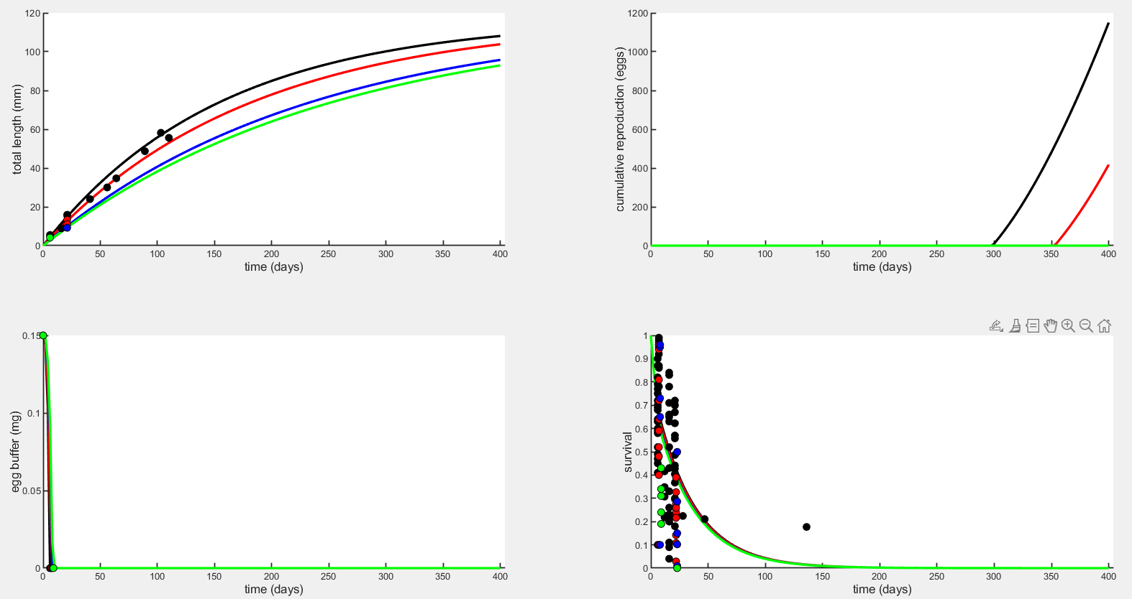
Full life plots – Yield coefficient for growth (yVA)

Slide 14
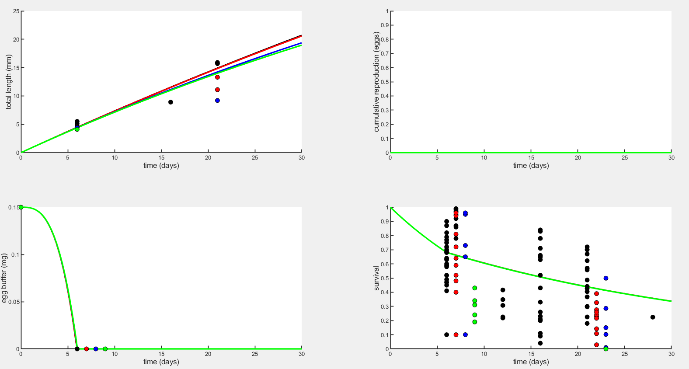
Early life plots – Maintenance (sJM)

Slide 15
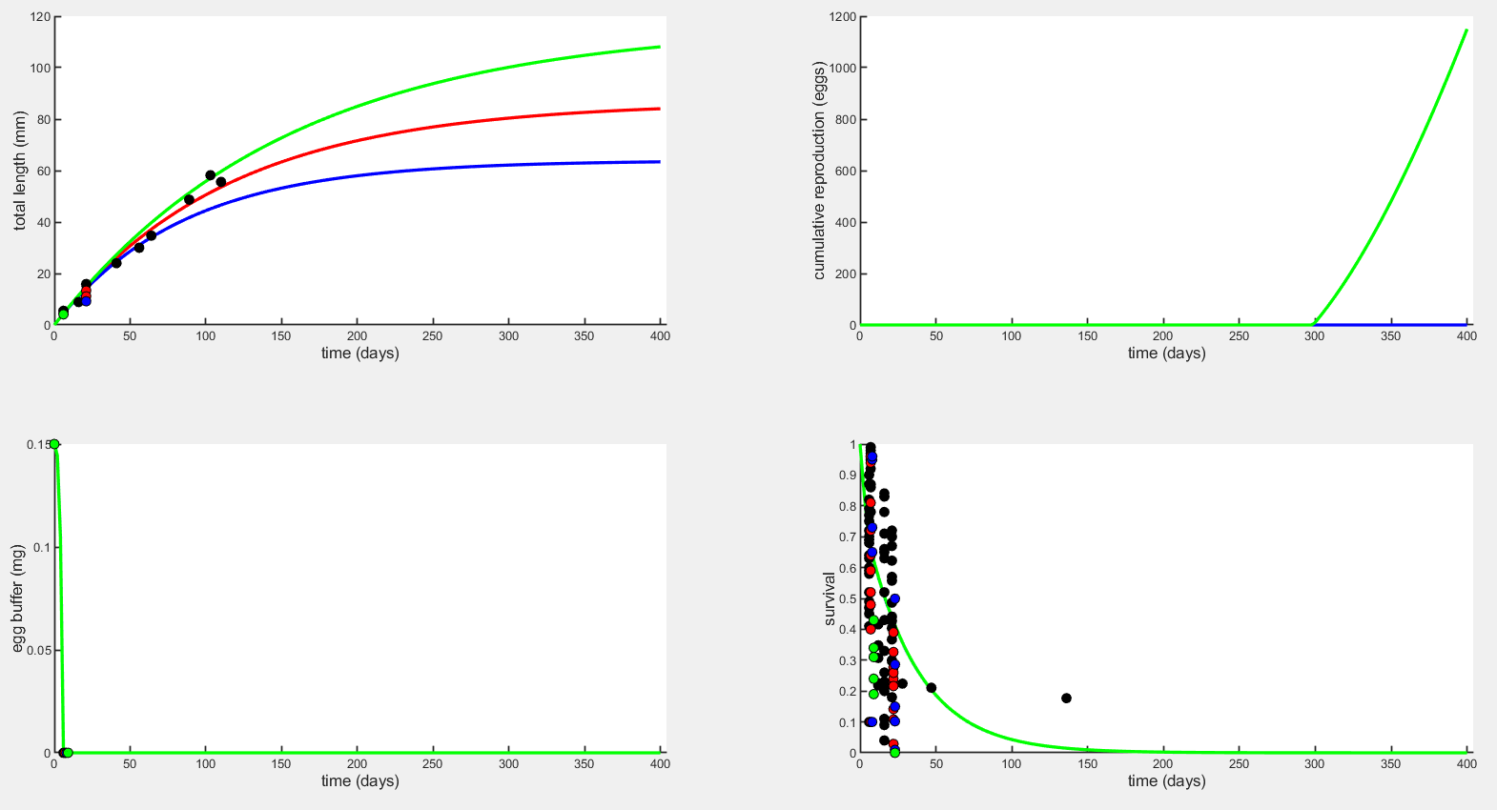
Full life plots – Maintenance (sJM)

Slide 16
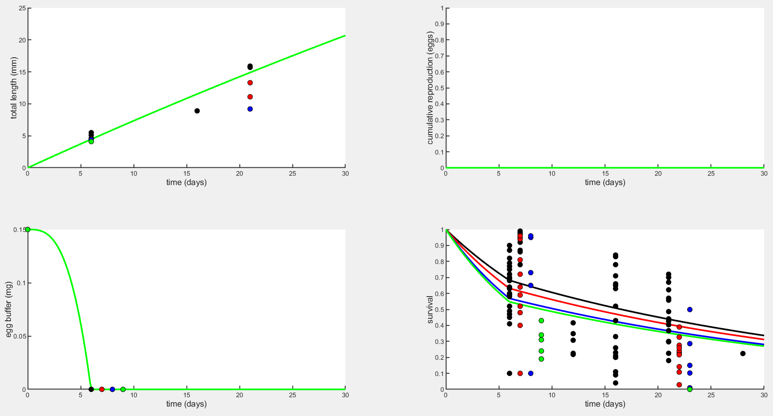
Early life plots – Embryo mortality (mu_emb)

Slide 17
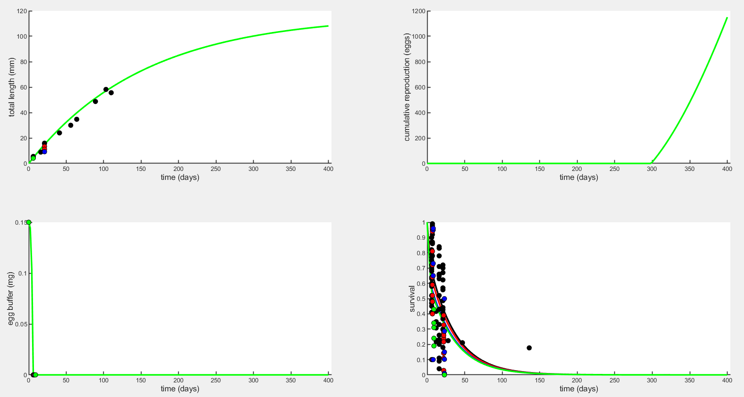
Full life plots – Embryo mortality (mu_emb)

Slide 18
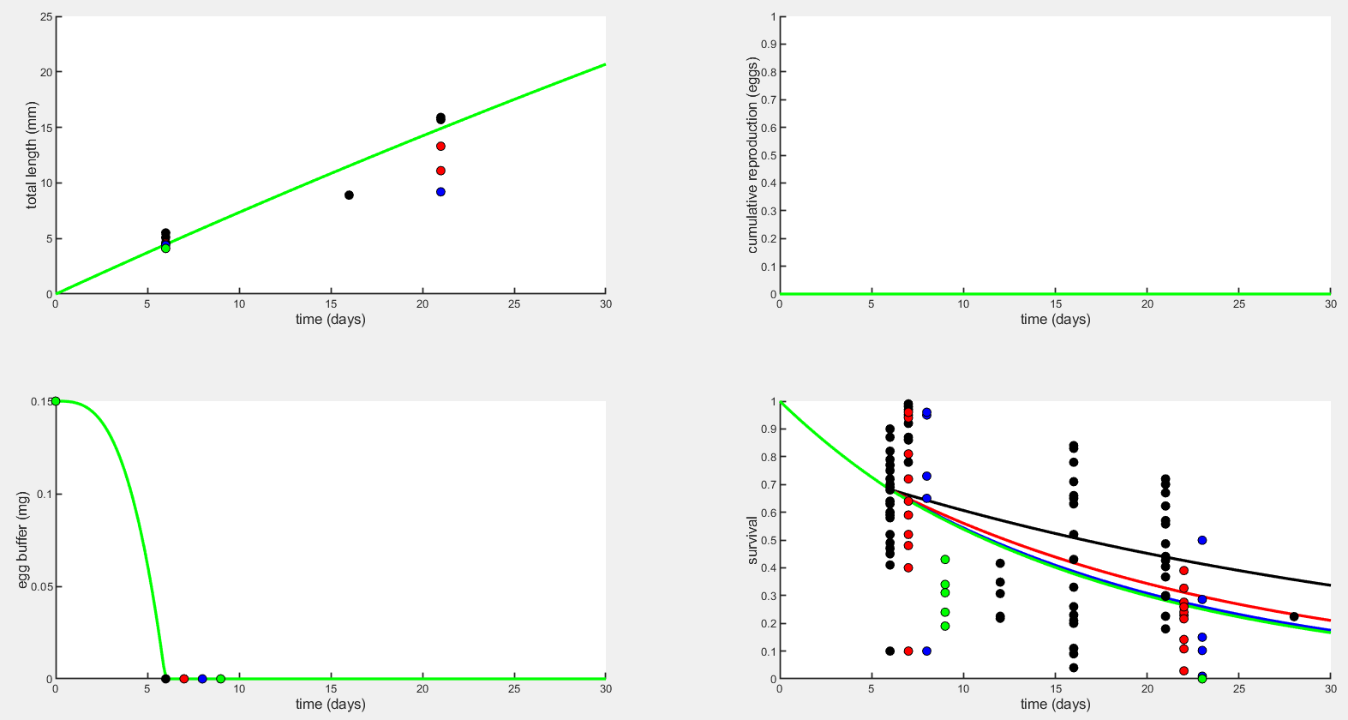
Early life plots – Larval mortality (mu_lar)

Slide 19
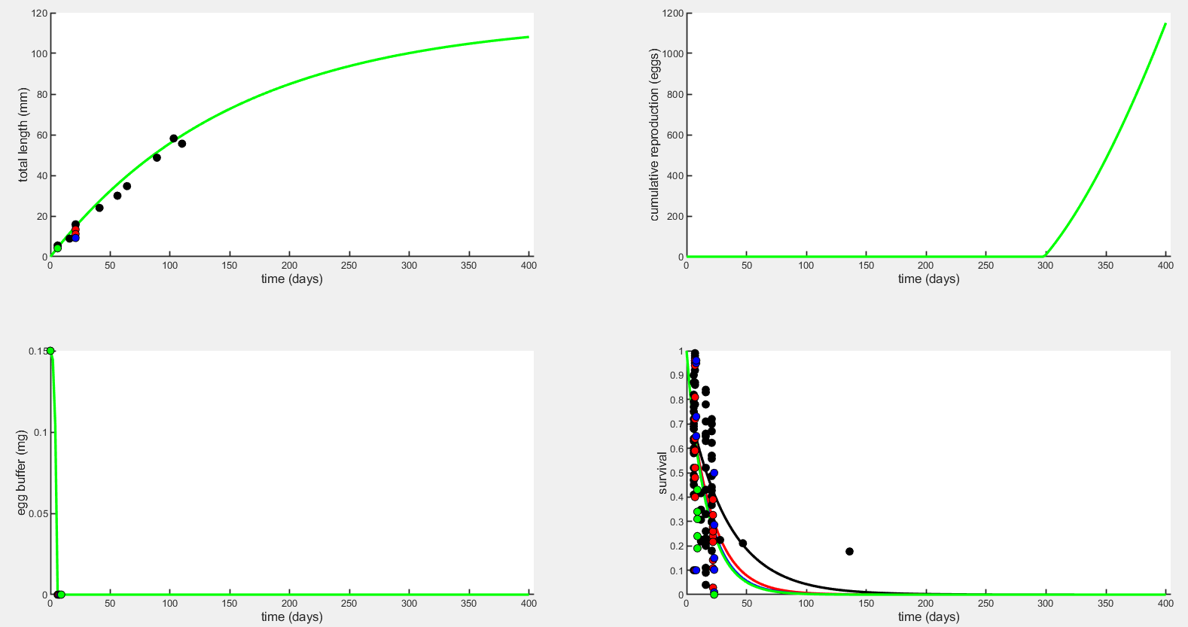
Full life plots – Larval mortality (mu_lar)

Slide 20
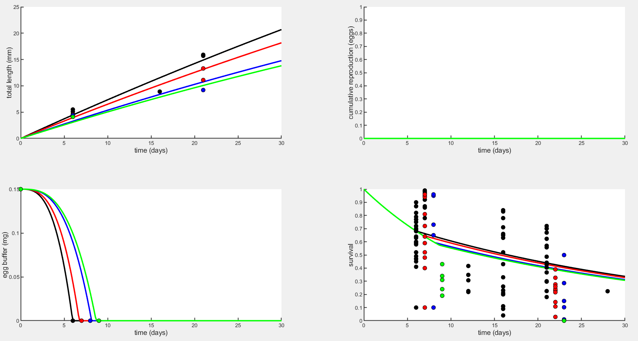
Early life plots – sJAm & sJM

Slide 21

Early life plots – sJAm & sJM

Slide 22
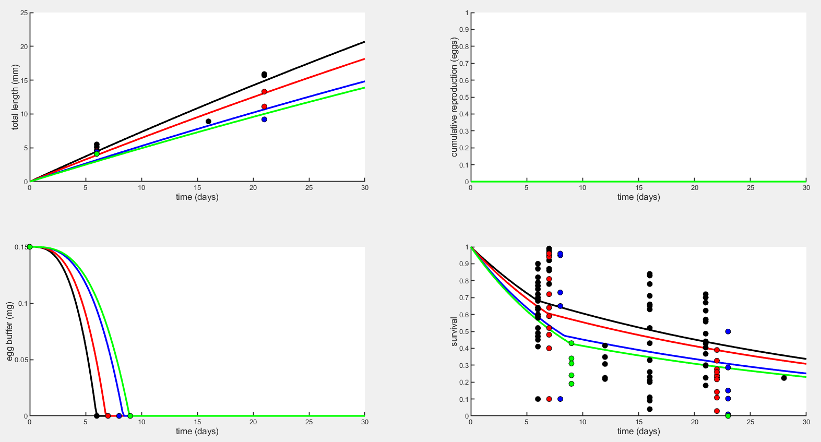
Early life plots – sJAm & mu_emb

Slide 23
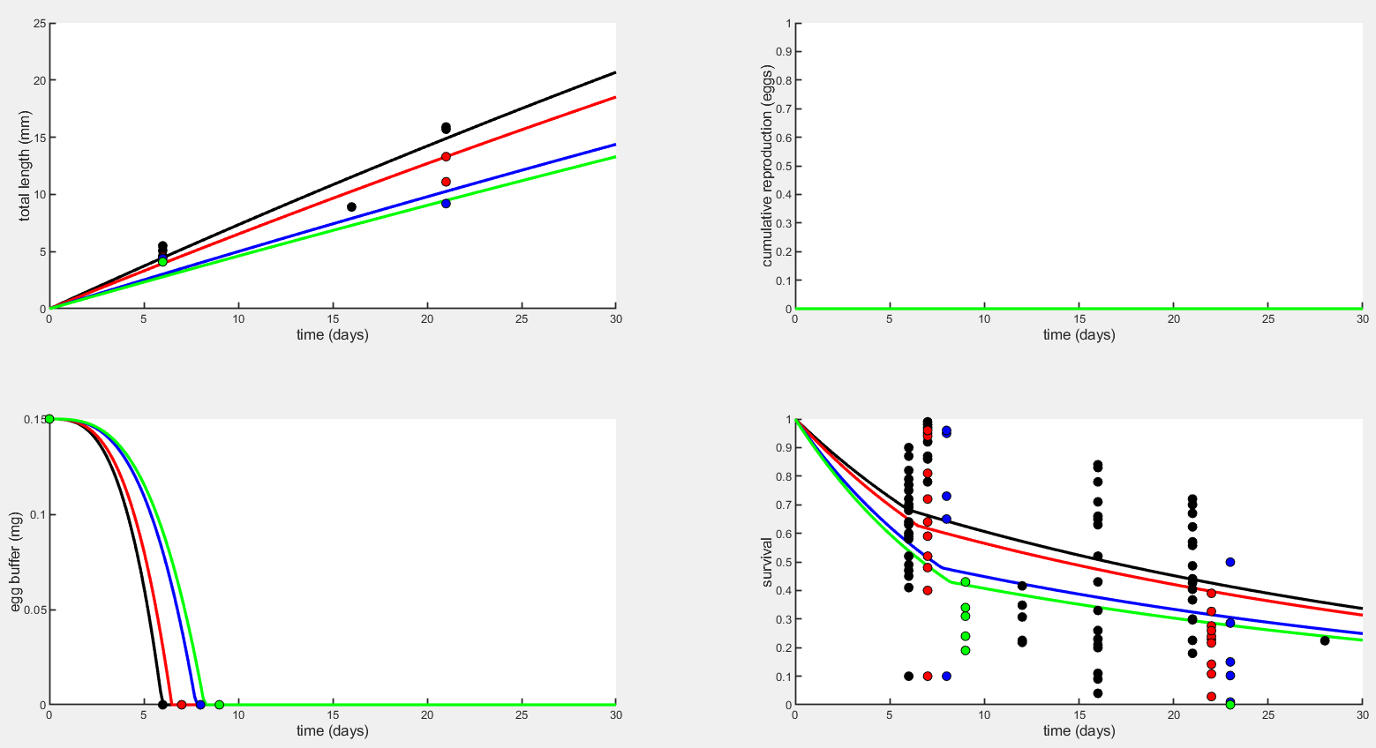
Early life plots – yVA & mu_emb

Slide 24
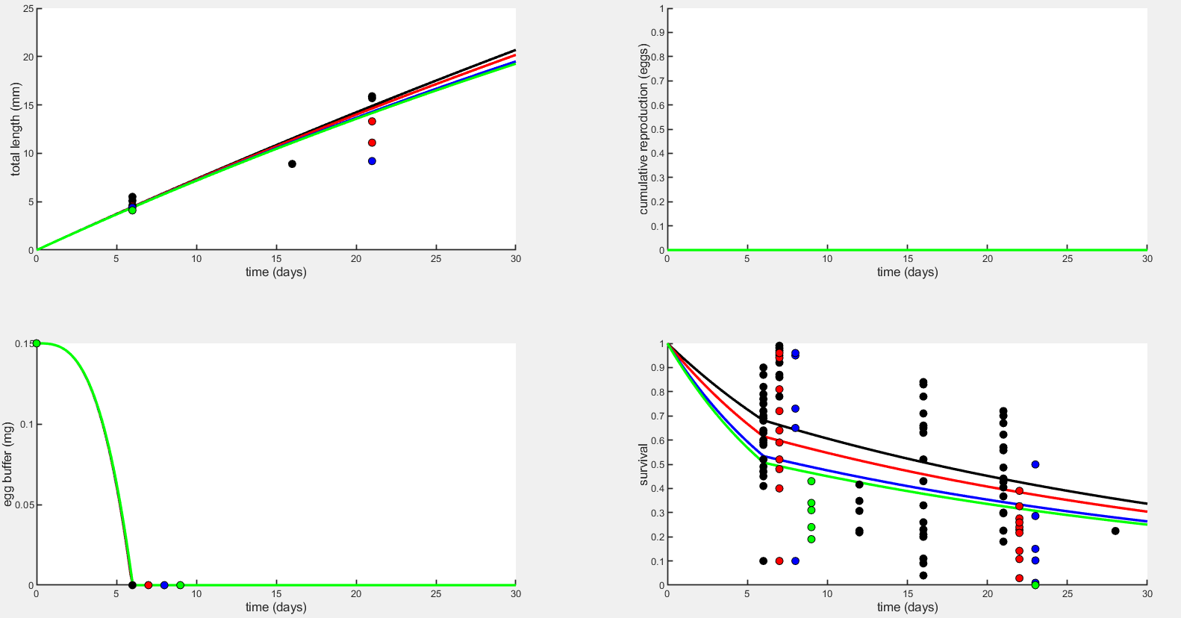
Early life plots – sJM & mu_emb

Slide 25
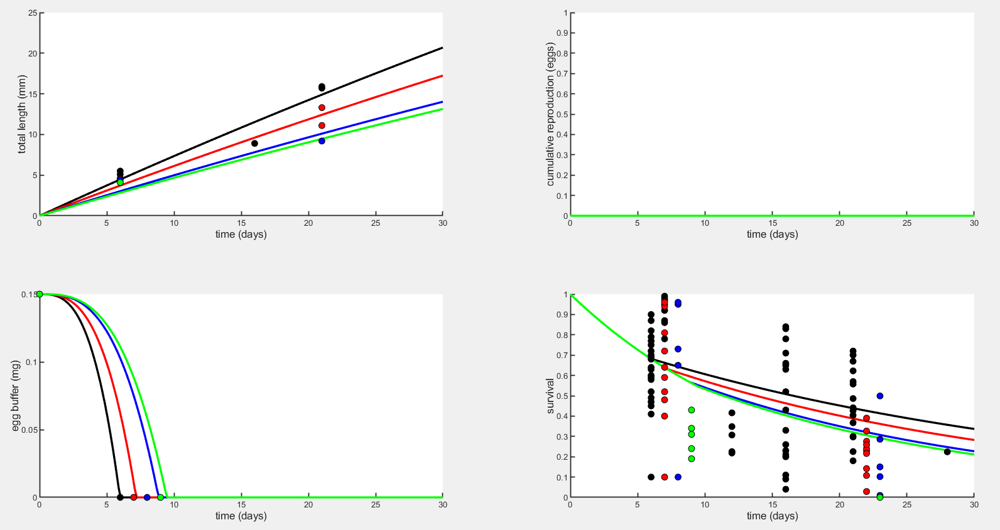
Early life plots – sJAm & mu_lar

Slide 26

Early life plots – yVA & mu_lar

Slide 27
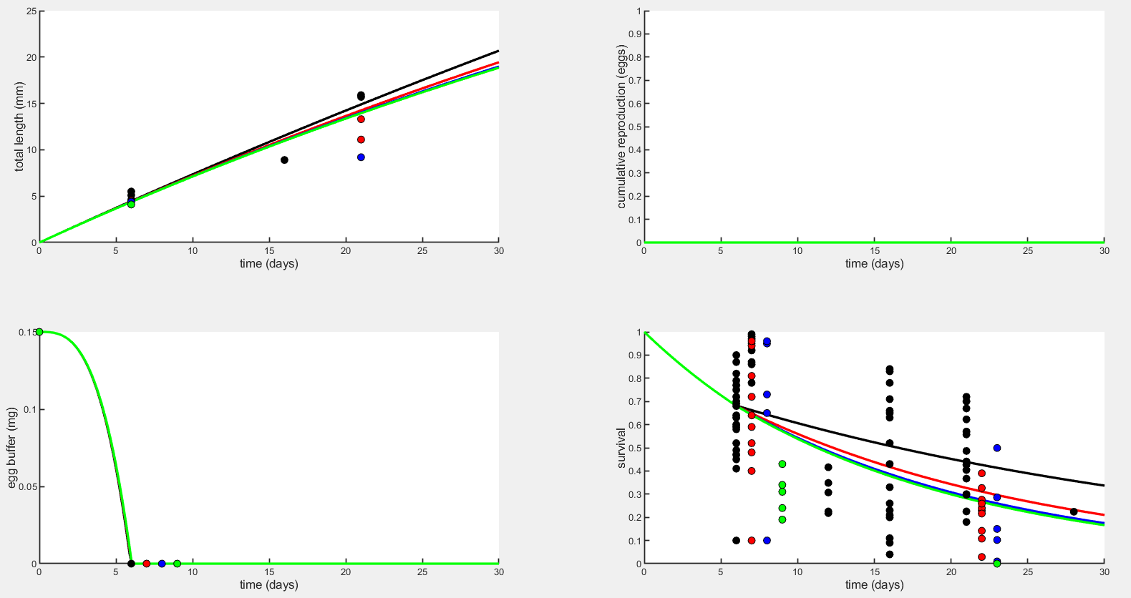
Early life plots – sJM & mu_lar

Slide 28
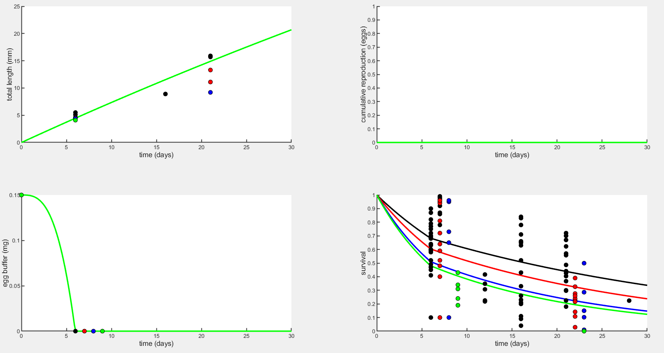
Early life plots – mu_emb & mu_lar

Slide 29
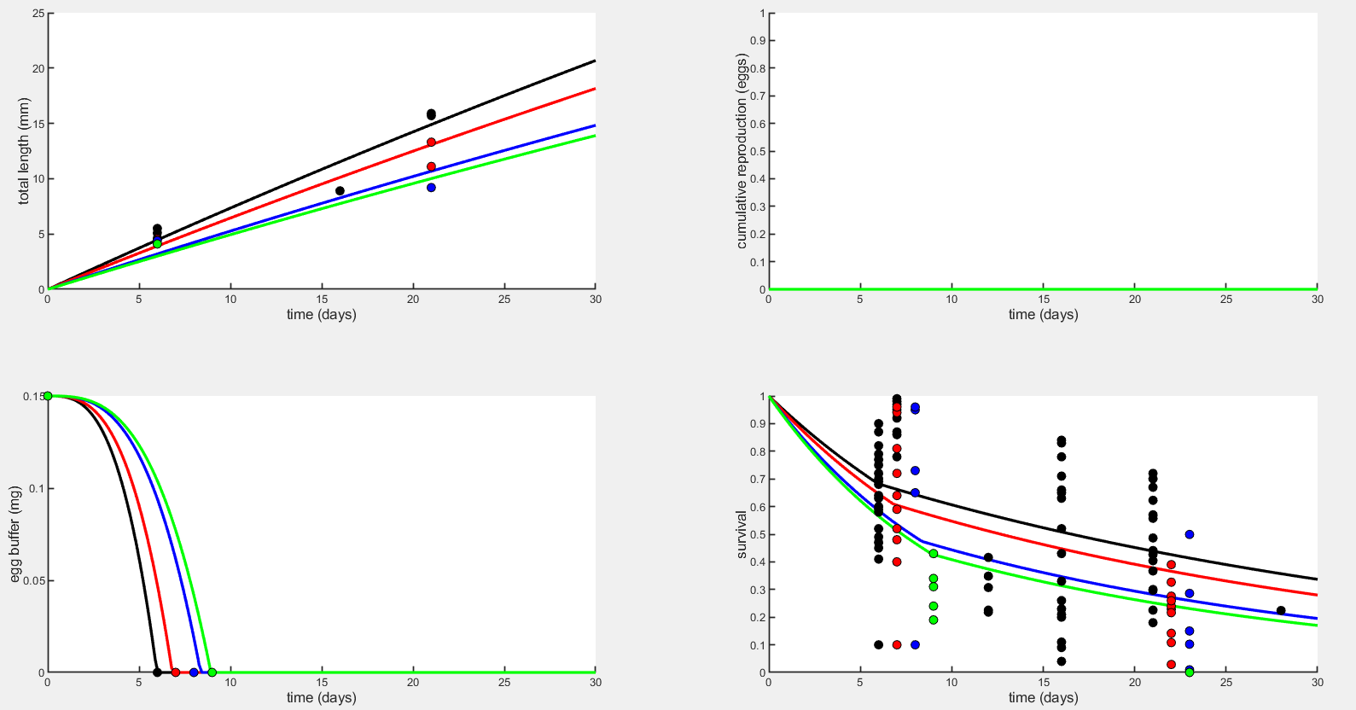
Early life plots – sJAm, mu_emb, & mu_lar

